Slide 1
THE LAST DRUMMER
TEAM
“FIVE” CENTS
COMPOSED BY:
Anisha Datla
Damini Chopra
Gaurav Suthar
Mohammed Afzal Sopariwala
Siddhesh Kulkarni

Slide 2

GOAL
To play drum and piano tones on FPGA using piezo plates and LCD touch screen
MOTIVATION
Passion for Music
Need of a portable music station
Challenging to implement
Application: Can be used as a music starter kit for newbies.

Slide 3
Specifications
The foremost requirement is that the FPGA should be able to generate a tone by itself (not from some microcontroller or mp3 player).
The speaker should generate tones in audible range depending on the variations in the input
The piezo plates should be sensitive enough to detect each hit
LCD should be interfaced to display the desired keys
The touch-screen should correctly respond to touch, by playing only the sound corresponding to the key being touched.

Slide 4
High Level Diagram

Slide 5
Functionality: Drums
For the drums, the user beats are recognized by the piezo plates which are connected to MSP430 that converts the analog signal to digital output.
FPGA generates drum tones as per the digital signals received from MSP430.
These signal are individually fed to PMOD-AMP2, which plays the corresponding tune through the speaker.
Piezo sensors
Analog Input
MSP430 WITH AD
Digital Output
PMOD
FPGA
Speakers

Slide 6
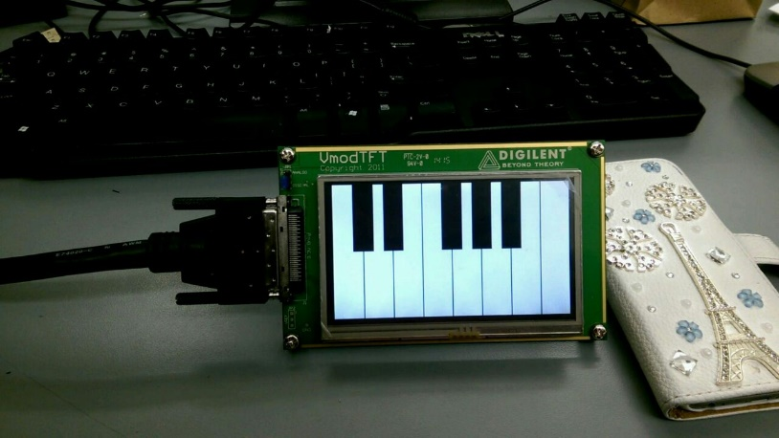
Functionality: Piano
The LCD touch screen (VMOD TFT) is connected to the FPGA through the VHDCI connector
A Piano image is displayed on the screen.
The LCD should detect a touch on the correct key.
Depending on the touch-screen input, different tunes are generated which are fed to the speaker via PMOD-AMP2.
VHDCI CABLE
FPGA

Slide 7
Detailed Functionality
Interfacing piezo plates:
As piezo plates generate analog output, we decided to use an MSP430 to convert it to a Digital signal.
We designed a code which converts the analog input from MSP430 to digital output.
This digital output is fed to the PMOD pins of FPGA, which are later processed to generate different tones accordingly
Generating sound from speaker:
In order to generate the desired notes from the speaker, we first learnt how to interface PMOD-AMP2.
Making the SHUTDOWN’ and GAIN pins high, we were able to activate it.
To achieve audible notes, we designed a program which divides the clock frequency to around 300Hz, and toggles the speaker pin in that frequency.
This is the way we generated “firing tones”
It should be noted that the speaker makes sound only when speaker pin toggles (and not at all in any other case).

Slide 8
Detailed Functionality (Cont.)
For generating the “Desired” tones:
In order to generate the desired tones, we are first giving an 8 bit value to a variable “note”
This value is then divided by 12 which gives the octave and the scale in which the tone is playing
In order for the scale and octave to work correctly, both of them are decreased by 1 in two separate always loops
This results in the scale being divided by octave. So every time the scale and octave are zero simultaneously i.e. octave is a perfect multiple of the scale, a basic note is generated.
Depending on the instance at which the note is generated, a particular tone is played

Slide 9
Detailed Functionality (Cont.)
Touch screen LCD(480x272)
The VMODTFT is powered on by enabling the signals as shown in the figure
We created a sync module similar to VGA that scans the x and y axis using counters
By specifying the counter values and pixel colors, the static image of the piano was created
The LCD and Touchscreen need to be used separately to get good results
A touchscreen press generates an interrupt and outputs the digital values through Dout pin.
The corresponding co-ordinates can be obtained from these digital values.
Finally the coordinates can be mapped to the specific piano tone.
TFT_en: is to enable the LCD
TFT_clk:9Mhz pixel clk
DE clk – combination of Hsync and Vsync
DISP – Valid display area,
EN – Led_en for backlight

Slide 10
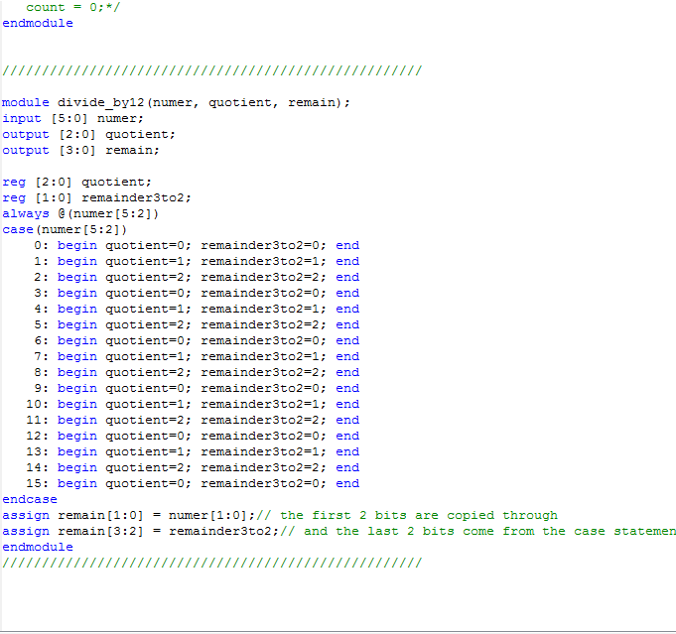
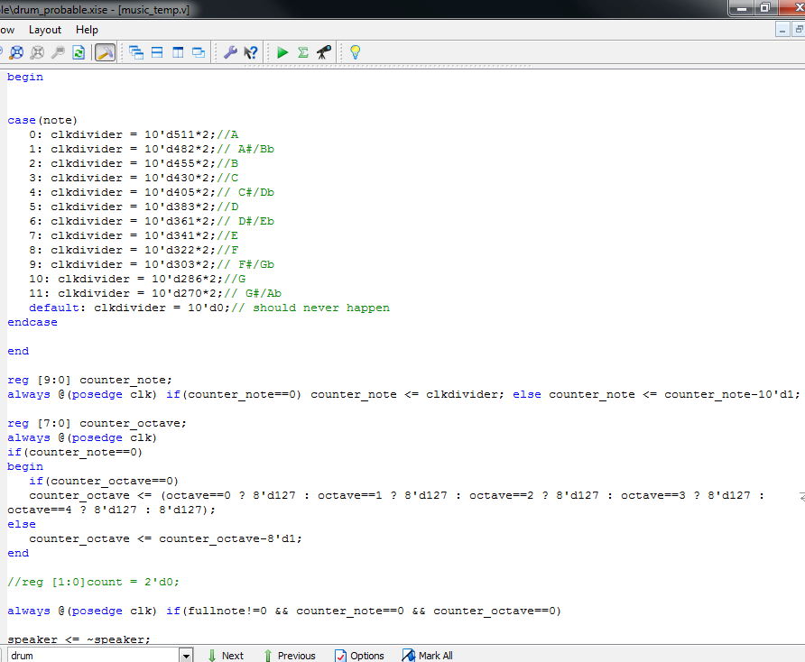
AWESOME CODE (Code for generating the notes)

Slide 11
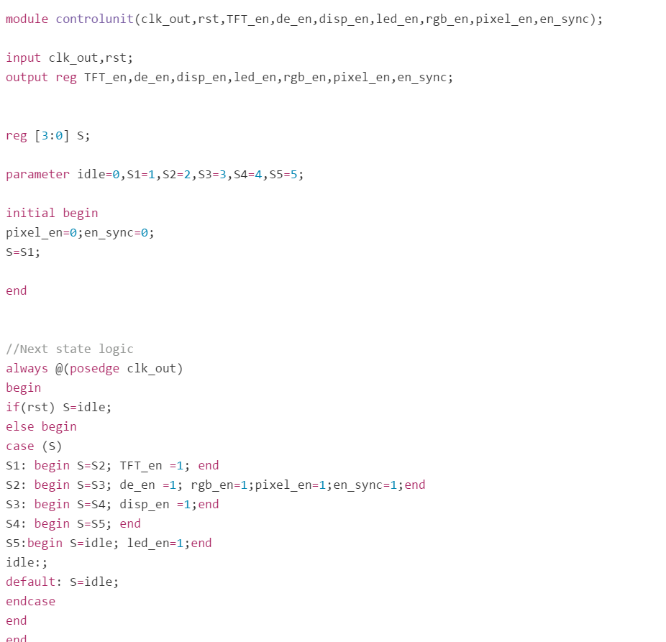
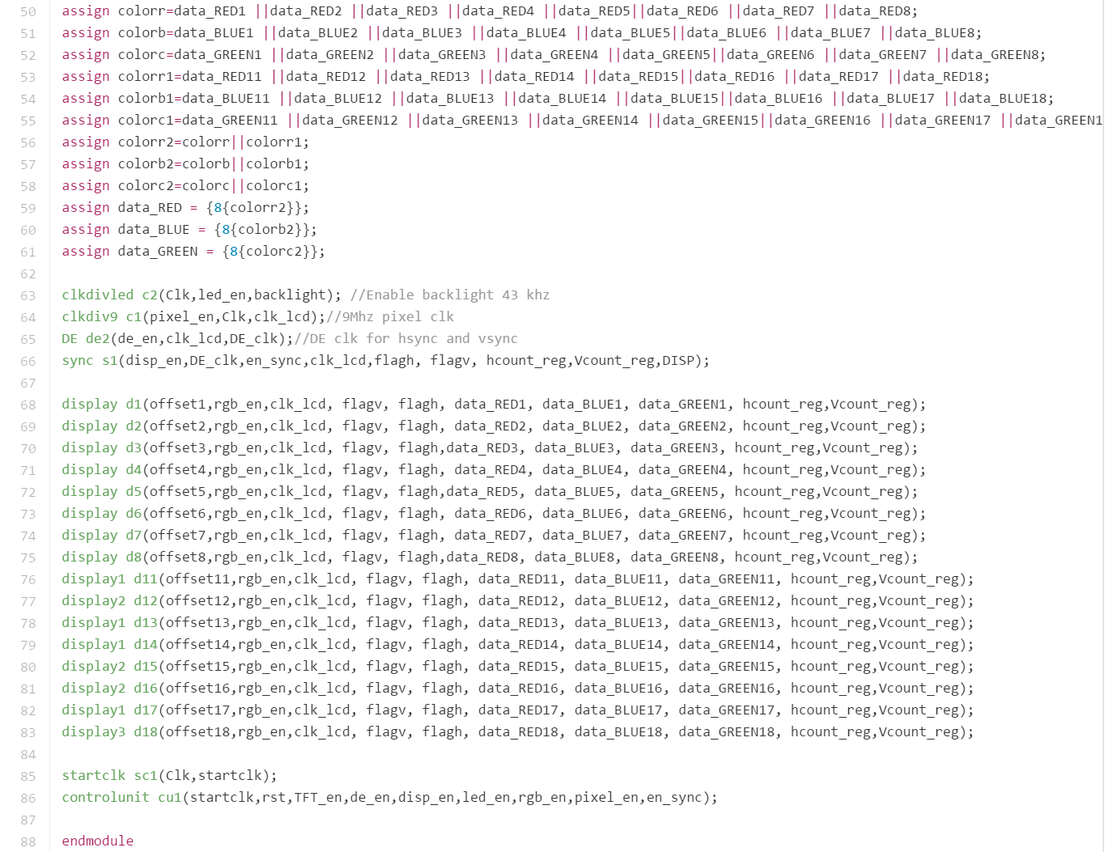
ANOTHER AWESOME CODE

Slide 12

Success
Interfaced speaker to FPGA through PMOD-AMP2
Interfaced piezo plates to FPGA through MSP430
Successfully generated correct piano tones from FPGA
Interfaced LCD touch screen to the FPGA to display the piano.
Punched the Keyboard
Generated working Verilog code ☺

Slide 13

Uncompleted tasks
Drum tones still not synthesized up to standards. Working on different methods to generate proper-sounding drum tones.
Processing touch inputs from the LCD display and generating piano tones for each touch.
Finishing touches to make it a proper consumer product i.e. the basic user-interface
Will be done by next week.

Slide 14
Work-Distribution
Piezo-Electric Module | Generating tones | LCD Module
Anisha | Afzal | Afzal
Damini | Gaurav | Anisha
Gaurav | Siddhesh | Damini
 |  | Siddhesh

Slide 15
